Slide 1
WELCOME TO OUR PROJECT
EMERGING METHODS FOR EARLY
DETECTION OF FOREST FIRES

Slide 2
TEAM DETAILS
TEAM ID : PNT2022TMID29437
PROJECT TITLE : Emerging Methods for Early Detection of Forest Fires
INDUSTRY MENTOR (S) NAME : Shanthi
FACULTY MENTOR (S) NAME : Mohanarangan S
TEAM MEMBERS : Harish R (Team Lead)
Manojkumar S
Avinash Auxilian J
Logesh N

Slide 3
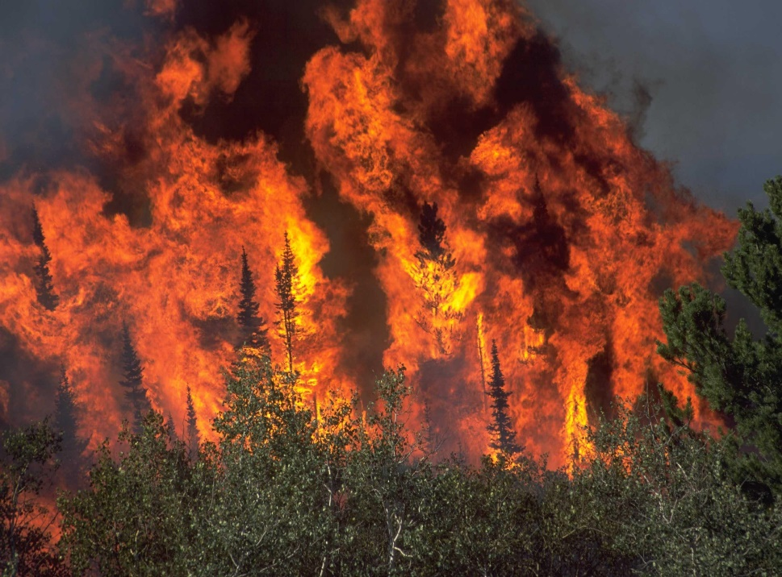
PROBLEM STATEMENT
Forest fires are a major environmental issue, creating economic and ecological damage while endangering human lives. There are typically about 100,000 wildfires in the United States every year.
Over 9 million acres of land have been destroyed due to treacherous wildfires. It is difficult to predict and detect Forest Fire in a sparsely populated forest area.
Every year, there are an estimated 340,000 premature deaths from respiratory and cardiovascular issues attributed to wildfire smoke.
The increasing frequency and severity of wildfires pose a growing threat to biodiversity globally.

Slide 4
PROBLEM STATEMENT
Fire detection is crucial task for the safety of people. To prevent damages caused by fire, several fire detection systems were developed. One can find different technical solutions. Most of them are based on sensors, which is also generally limited to indoors.
However, those methods have a fatal flaw where they will only work on reaching a certain condition.
In the worst-case scenario, the sensors are damaged or not being configured properly can cause heavy casualty in case of real fire.
Those sensors detect the particles produced by smoke and fire by ionization, which requires a close proximity to the fire. Consequently, they cannot be used for covering large area. To get over such limitations video fire detection systems are used.

Slide 5
PROPOSED SOLUTION
To overcome such critical situations, we proposed a Forest Fire Detection system using Convolution Neural Networks (CNN) which can detect fire in varying indoor and outdoor environments.
To balance the efficiency and accuracy, the model is fine-tuned considering the nature of the target problem and fire data. Experimental results on benchmark fire datasets reveal the effectiveness of the proposed framework and validate its suitability for fire detection.
It uses Computer Vision (CV) Technology to detect the forest fire by video frames given to the Deep learning model. If it predicts the fire detection then it will alert.
This proposed system is fast and accurate in detecting the forest fires from the images and videos and it does not requires any sensors to detect the flame or smoke.
It is highly effective in detecting the forest fires earlier and send alert message to the users when fire is detected.

Slide 6
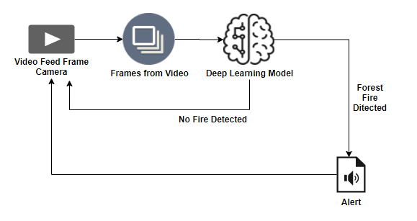
TECHNICAL ARCHITECTURE

Slide 7
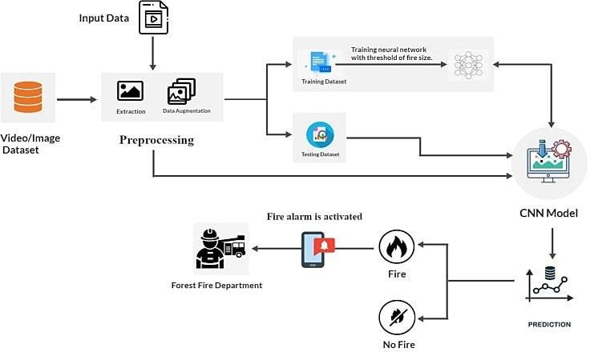
DETAILED ARCHITECTURE

Slide 8
WORKING DEMO OF OUR PROJECT

Slide 9


PERFORMANCE METRICS (RESULTS)
Model Summary : Total parans : 195,052,397
Trainable parans : 195,052,397
Non-trainable params : 0
Accuracy : Training accuracy : 0.9266
Validation accuracy : 0.9688

Slide 10
SCALABILITY / FUTURE SCOPE
The availability of fire-fighting technology brings us one step closer to new AI for detection and security in the forest and at home.
With the addition of a motion sensor, the technology can simply expand to compact decision-making with the addition of new software and hardware.
Fire detection systems can be connected to sprinklers that will automatically respond when a fire is detected. The potential benefits, feature of interest for forest fire detection monitoring and providing assistance to firefighting have been highlighted in the review of the literature.
Fire accidents can be detected using the cameras. So that, here we proposed a CNN approach for fire detection using cameras. Our approach can identify the fire under the camera surveillance.
The system is utilized as a drone and surveillance system UAV to expand the surveillance area and detect heat signatures in order to identify human from fire plasma signatures.

Slide 11
THANK YOU!!!

